Slide 1

Bharat Nav
A real time safety route mapping
-developed by: Sonal Bera and Ritik Garg

Slide 2
Current situation:
Because you must look before you leave!
We know that Delhi has got the dubious distinction of topping the list in cases of murder, kidnapping and abduction, juveniles in conflict and economic offences.
Delhi reported 33% (13,803 cases out of total 41,761 cases in 19 cities) of total crimes against women, followed by Mumbai at 12.3% (5,128 cases) last year among the 19 cities with population above two million

Slide 3
How to resolve this issue?
Google map tries to find the fastest route between two paths even if it may mean compromising on security.
But we have a solution. We aim at detecting the safest route by finding danger index of all possible paths between two places which is a weighted sum of numeric values our unsupervised machine learning algorithm devised and assigned to 166 places in Delhi.

Slide 4
Working algo:
We have applied Unsupervised Machine Learning Algorithm to find danger index of multiple routes between two places.
We have used a Clustering algorithm : K-Means , to rate criminal activities of 166 places on the map of Delhi in range of 0 to 4.K-means clustering is a type of unsupervised learning, which is used when you have unlabeled data (i.e., data without defined categories or groups). The goal of this algorithm is to find groups in the data, with the number of groups represented by the variable K.
The algorithm works iteratively to assign each data point to one of K groups based on the features that are provided. Data points are clustered based on feature similarity.

Slide 5
Implementation of our solution:
We used Google map and google places API to display all possible routes between any two location along with danger index of that route.
An autocomplete feature of the search bars lets the user select starting and destination locations along with the mode of travel i.e. walking , driving or transit.
This leads to displaying routes with markers indicating danger level of a place that falls on that route.The data below the map shows relevant statistics like time durations , distance and safety index of all possible routes between two places entered.

Slide 6
Color schemes:
Green Ticks: Safest
Smiley: Moderately safe
Exclamation mark: Be careful
Skull: Moderately dangerous
Cross: Extremely dangerous( not recommended)

Slide 7
.
Our website is live at :
https://obscure-taiga-70475.herokuapp.com

Slide 8
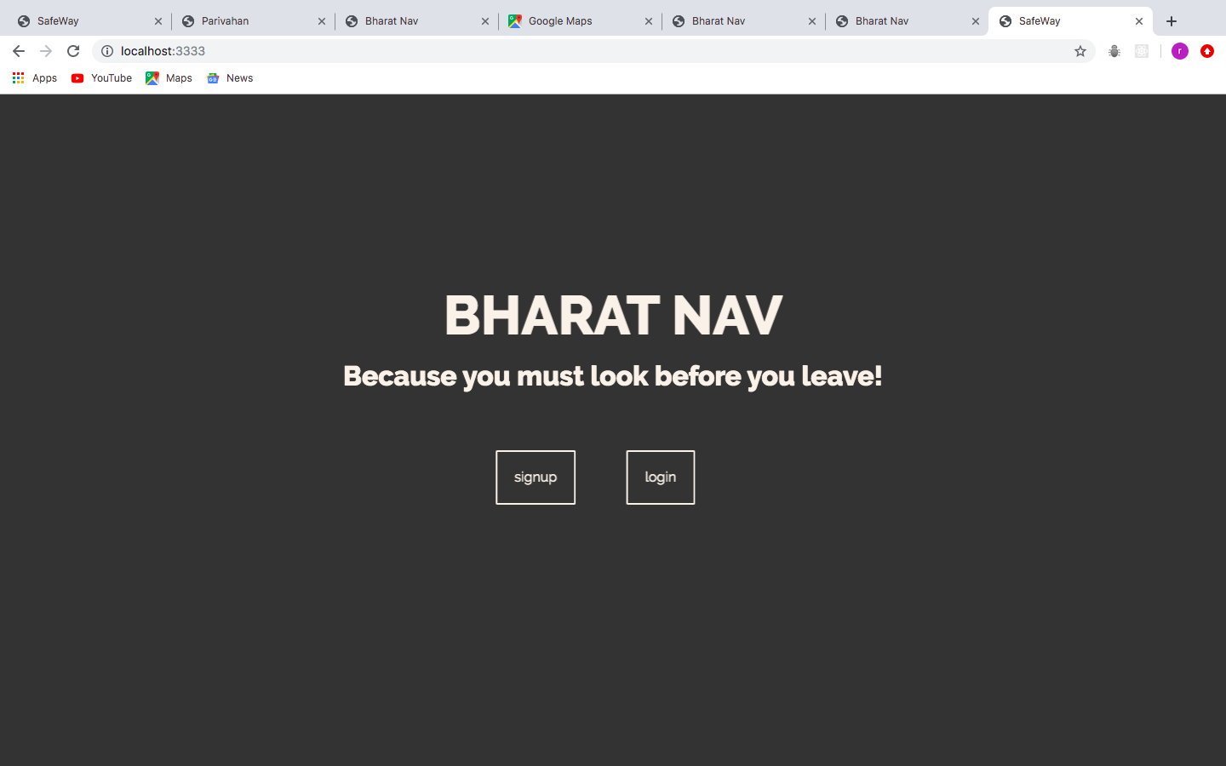
Some screenshots of our developed project :

Slide 9
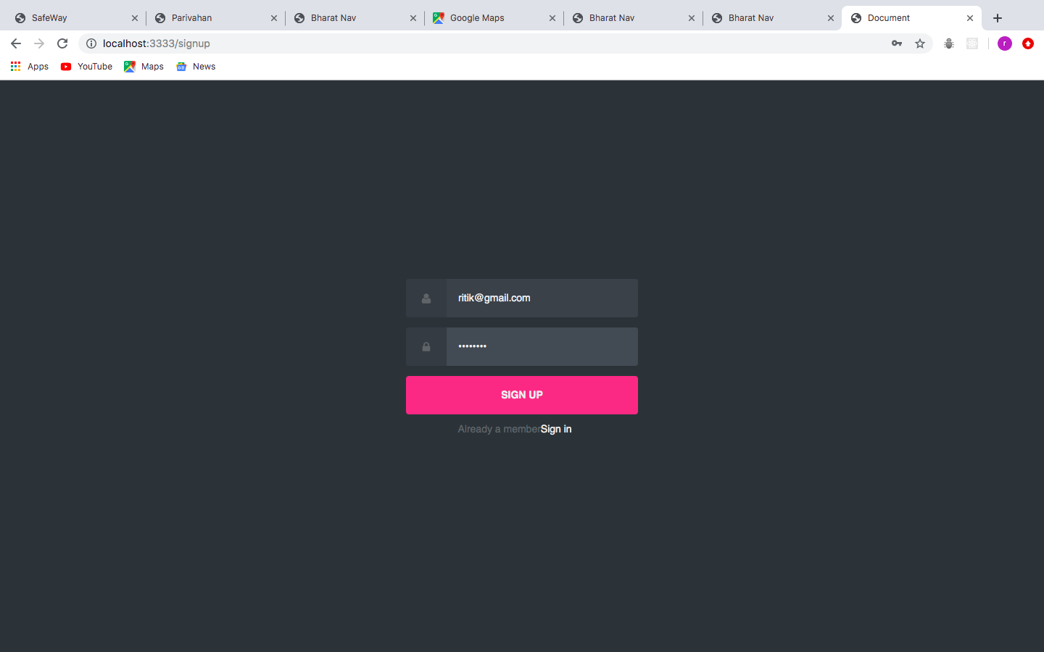
Login page

Slide 10
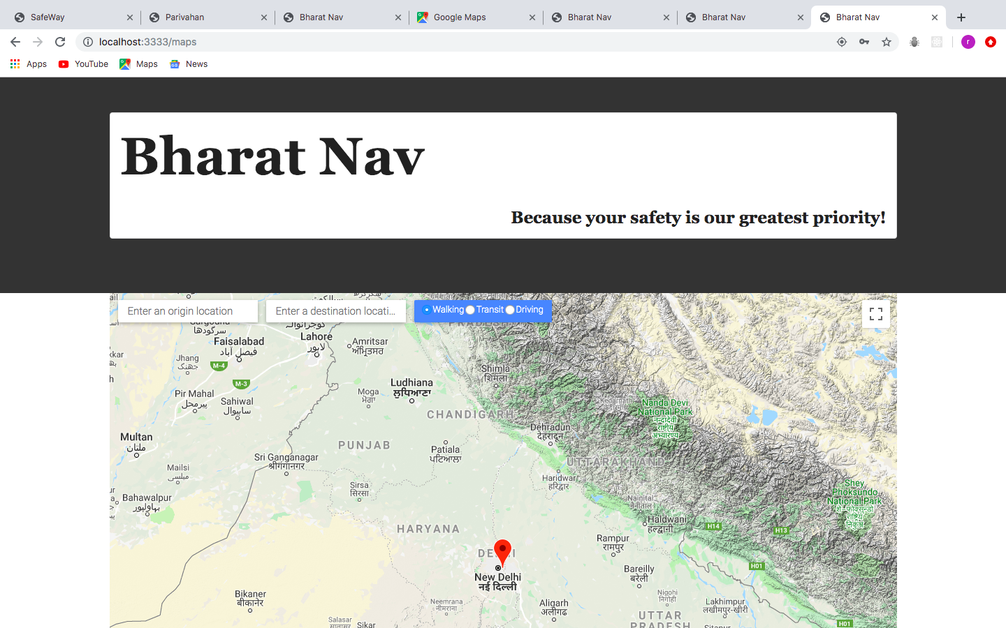
Working page

Slide 11
Conclusion
Due to some issues, the Google Maps API is not running. Sorry for the inconvenience.
Developed by:-
Sonal Bera
Ritik Garg

